Slide 1
Nor'easters and their impact on the Blue Hill Region
Amanda Joly
Meteorologist, Weather Observer
Graduate Student UMass Lowell

Slide 2
Blizzard, Snowstorm, or Nor’easter?
Blizzard | Snowstorm | Nor’easter
Sustained winds or frequent gusts of 35mph or higher | Temperatures near or below freezing (32°F) | A powerful low-pressure system that impacts the Mid-Atlantic and Northeast regions of the US
Visibility of ¼ mile or less due to falling or blowing snow | A wintery mix of precipitation | Features strong northeasterly winds
Forecasted continuation of these conditions for at least 3 hours | Precipitation can be in the form of snow, sleet, ice, or freezing rain | Precipitation can be in any form (rain, snow, mix, etc.)

Slide 3
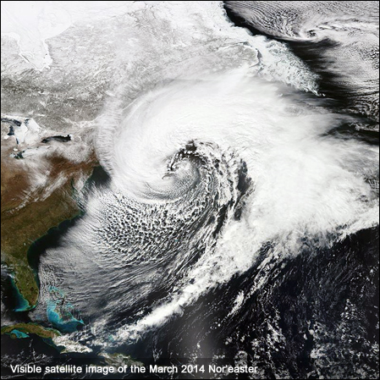
Nor’easters Defined
Often develops between Georgia and New Jersey, within 100 miles of the East Coast during October-May
Signature “comma” shape on satellite
Results in heavy precipitation (rain or snow), gale force winds (39-54 mph), choppy sea conditions, and sometimes coastal flooding
Named for the typical wind direction over the coastal area (sometimes northerly winds as well)

Slide 4
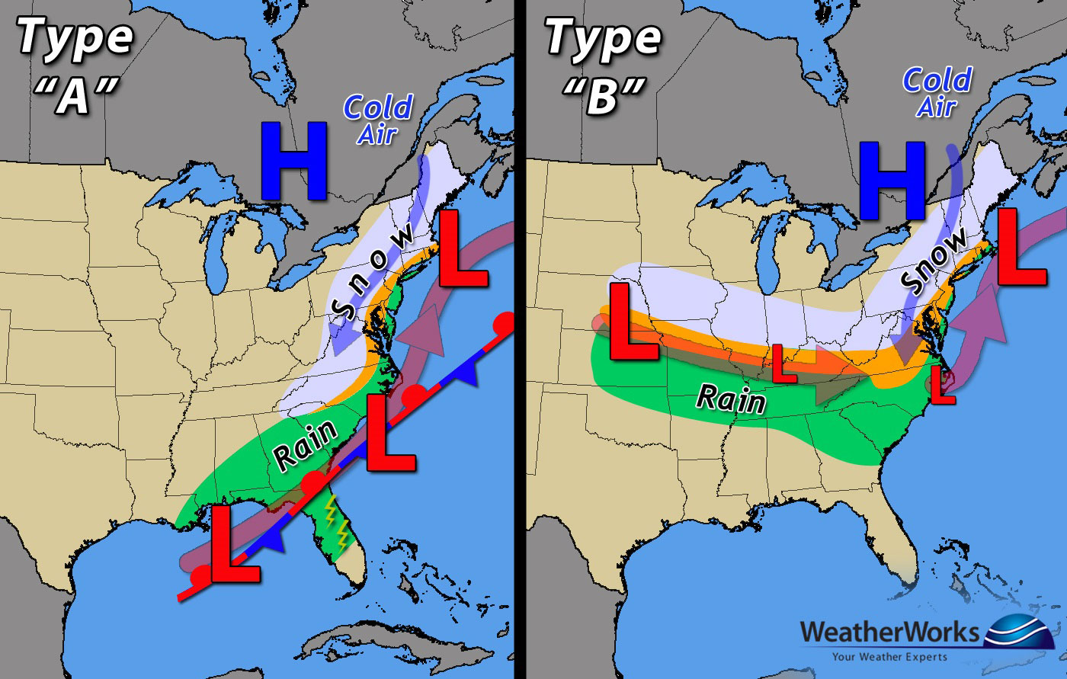
Types of Nor’easters: The Miller Classification
Type A is known as the Gulf of Mexico-Atlantic Ocean path
Type B is known as the Atlantic Coastal redevelopment path
Both draw energy from the Gulf Stream
There is no correlation to which type is stronger; they both can yield an impactful storm

Slide 5
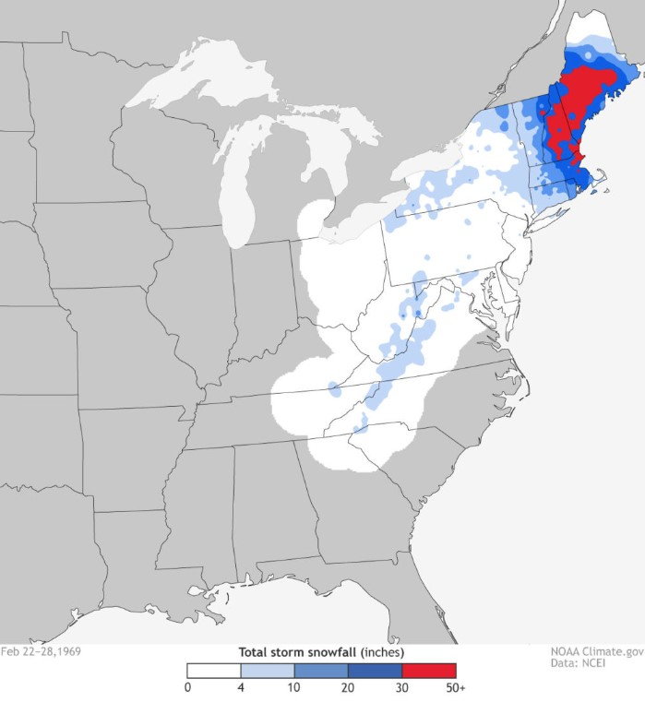
Historically Significant Nor’easters
“100-Hour storm”
Snowed from February 23 – 28,1969
Boston received 26.3” of snow, Blue Hill 38.7”
Mount Washington recorded 97.8” total with 49.3” falling in one day (Feb 25)

Slide 6
Historically Significant Nor’easters
“Blizzard of 1978”
February 6 – 7
70 mph winds and 27.1” of snow recorded in Boston
16ft snowdrifts were reported
Timing was during the afternoon commute, leaving many cars stranded
Blue Hill recorded 30.1” of snow during the blizzard

Slide 7
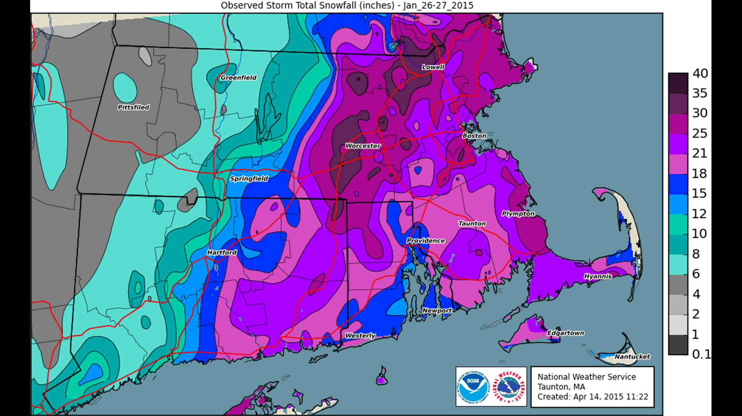
Historically Significant Nor’easters
“Blizzard of 2015”
January 23 – 31
Impacted our region on the 26th – 28th
2nd greatest snowstorm on record at Blue Hill with a peak gust of 51mph N and 30.8” of snow
Snow emergencies were declared in 6 states, with MA receiving the most snowfall

Slide 8
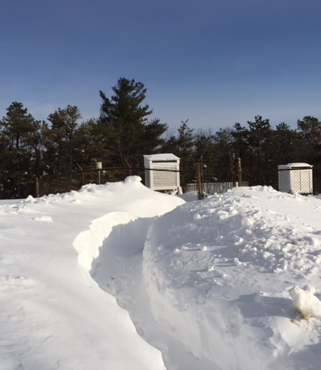
Notable Blue Hill Observatory Records
Peak Gust: 186mph S (calculated) – Sept 21,1938
Honorable mentions: 102mph S – Mar 9,1942 & Feb 3,1970
Heaviest Snowfall Event: 27.4 inches – Feb 24,1969
Honorable mention: 27.1 inches – Jan 29,2022
Greatest Snowstorm: 38.7 inches – Feb 24-28,1969
Honorable mention: 30.8 inches – Jan 26-28, 2015
Greatest Snow Depth: 46 inches – February 2015
Largest Rain Event: 5.61 inches – Mar 18,1968

Slide 9
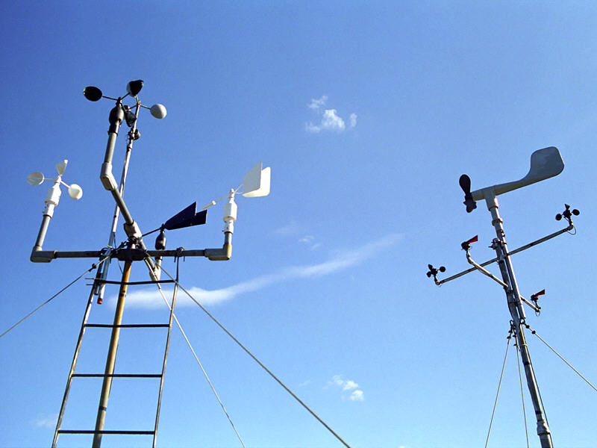
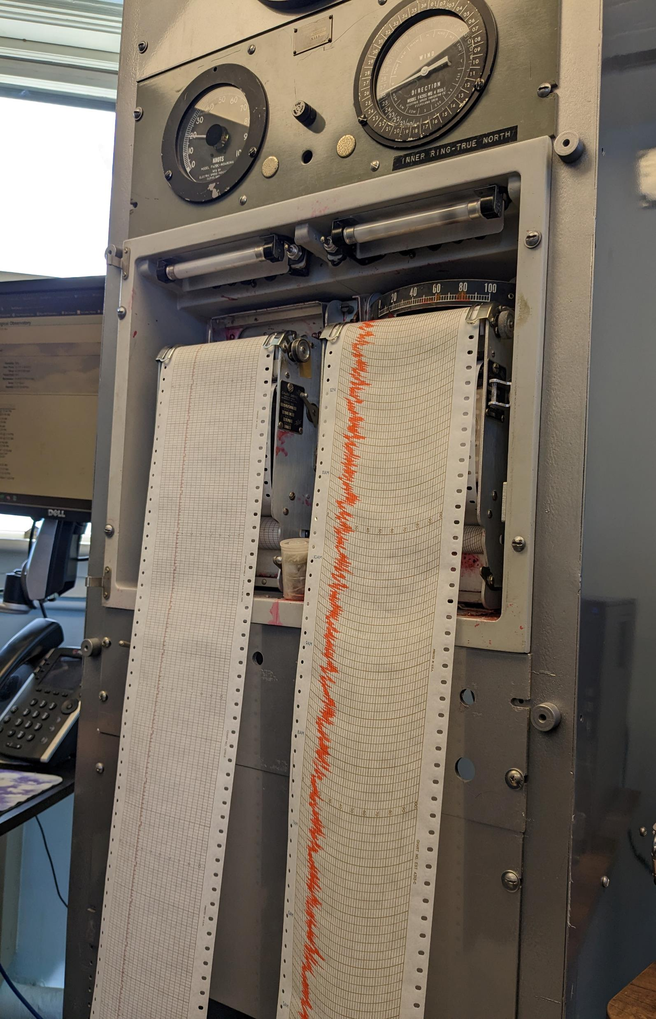
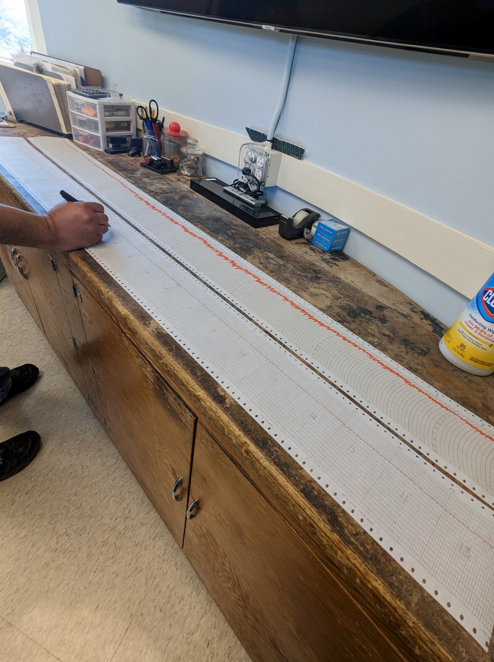
Measuring Nor’easter Data - Wind
Wind is measured by using anemometers in knots and mph
Blue Hill currently has 13 working anemometers; 3-cup and aerovane propeller types
Manual contacting anemometer to record fastest mile

Slide 10
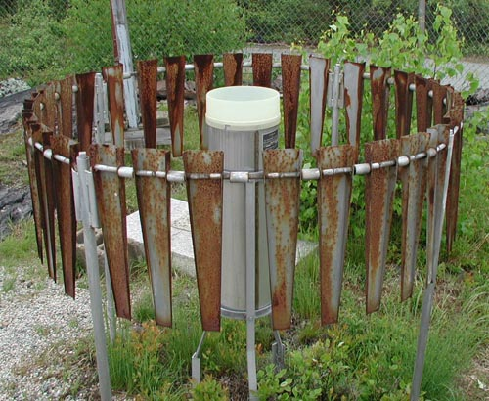
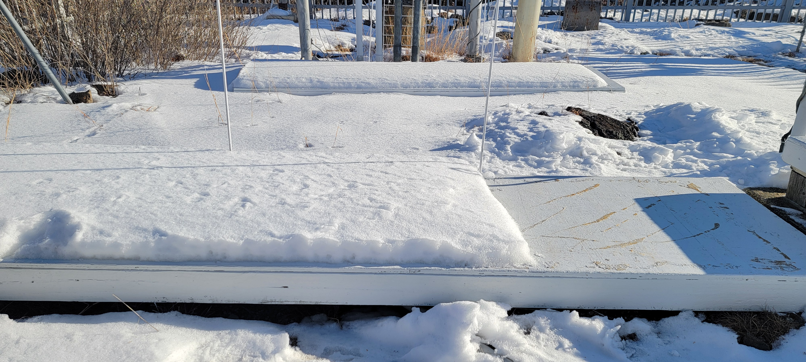
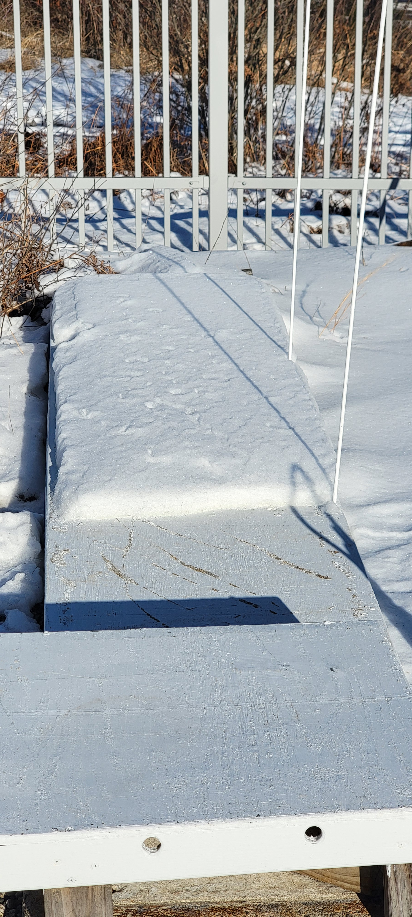
Measuring Nor’easter Data - Precipitation
Snow is collected, melted down, and measured for liquid equivalence
First 4’ section is for current 3-hour accumulation
Remaining board is for snow depth, measured at 7E and 13E
Snow is measured in tenths, snow depth is measured by whole inches

Slide 11
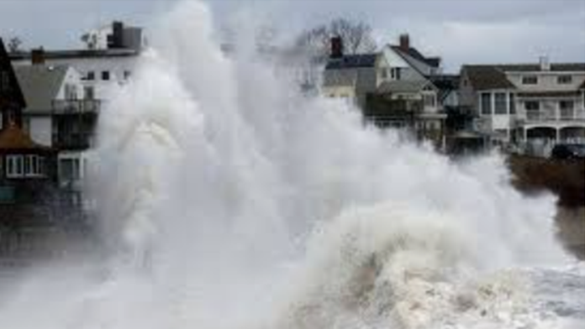
Preparing for Nor’easters
Sign up to receive alerts in your area and prepare an emergency kit
1
Bring in or secure objects from outside and check your rain gutters for clogs
2
Stay inside during the storm
3
Never walk through flowing water, or drive through flooded roads
4

Slide 12
Preparing for Nor’easters Resources

Slide 13
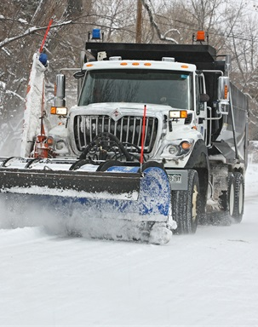
Cleaning up from Nor’easters
9-1-1 to report emergencies including gas leaks or downed power lines
2-1-1 for shelter locations and disaster information
Assess your home for damage, do not enter floodwaters, possible contamination
Disinfect and clean anything that got wet, dispose food that encountered floodwaters or has an unusual color, texture, or odor
Check on your neighbors!

Slide 14
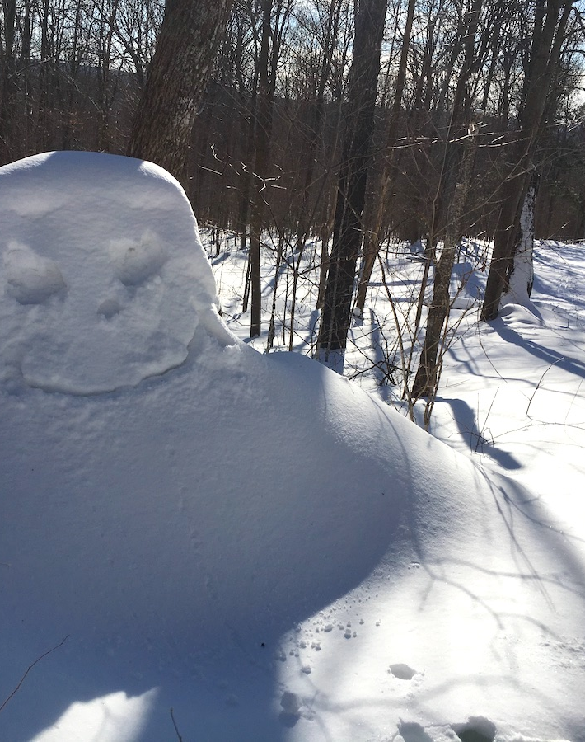
Cleaning up from Nor’easters- on the trails
Trail maintenance is vital for keeping the Blue Hills Reservation usable and beautiful
Preventative maintenance allows for easier storm clean-up
Adopt-A-Trail program and Trail Maintenance events are available
Being part of these volunteer efforts helps preserve the Reservation for current and future generations

Slide 15
Questions?
Thank you for attending!

